Slide 1

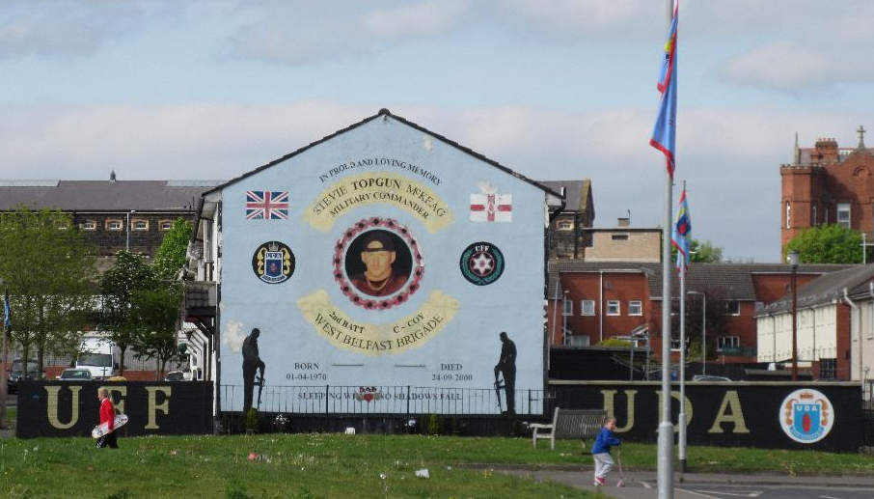
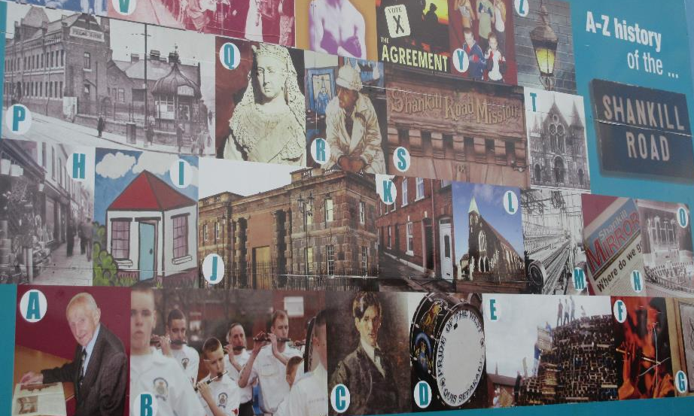
Ardoyne &
Shankill Roads
“It brings us back 20 years every time that parade goes down the road. You know, it brings this community back to what we have tried to move on and tried to let everybody else see that it has moved on” -(“Peace in Northern Ireland…”)

Slide 2
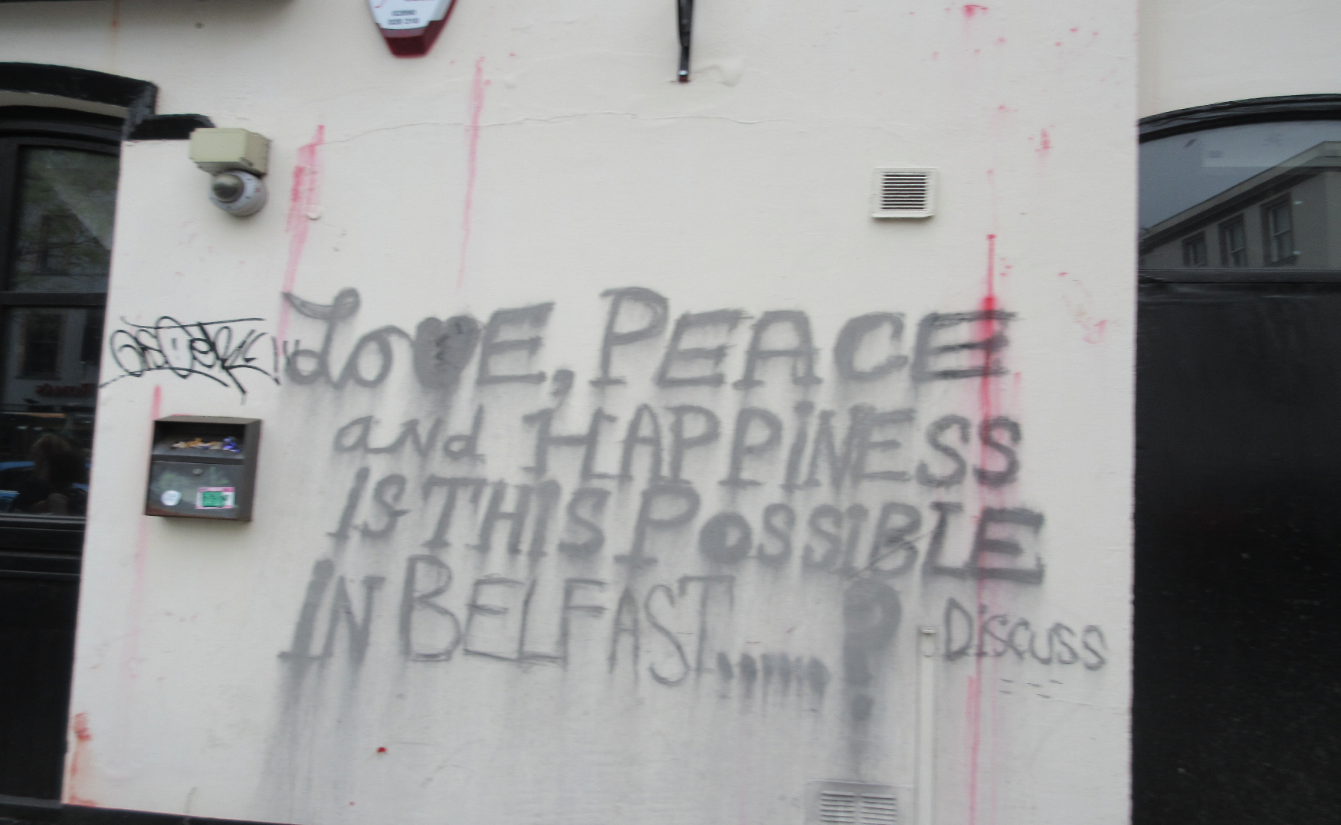
“Localised unrest possible in July-August during marching season; avoid all associated public gatherings”
(Travel Security Online)

Slide 3
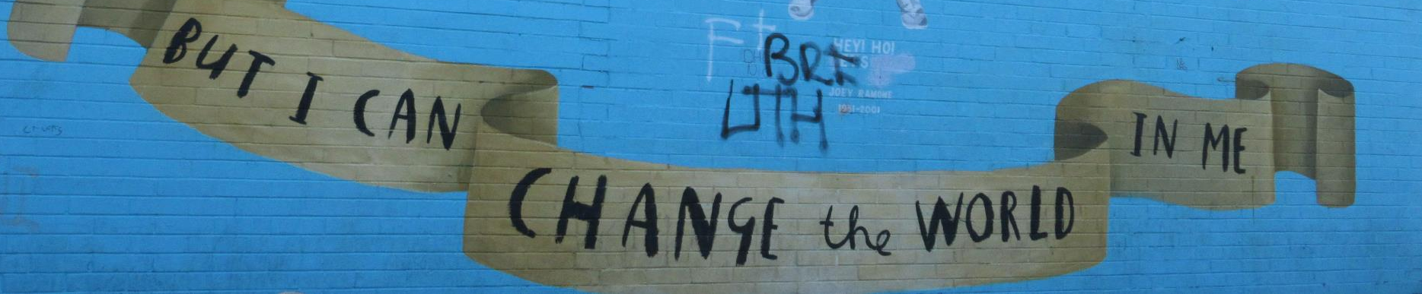
“Well, if we don’t, the other side is going to take over”
“Conflict hasn’t changed, to be honest with you”
(“Peace in Northern Ireland…”)
“I think it’s totally illegitimate to use any means of violence to protest or to express opposition to someone else’s culture.” (“Peace in Northern Ireland…)

Slide 4
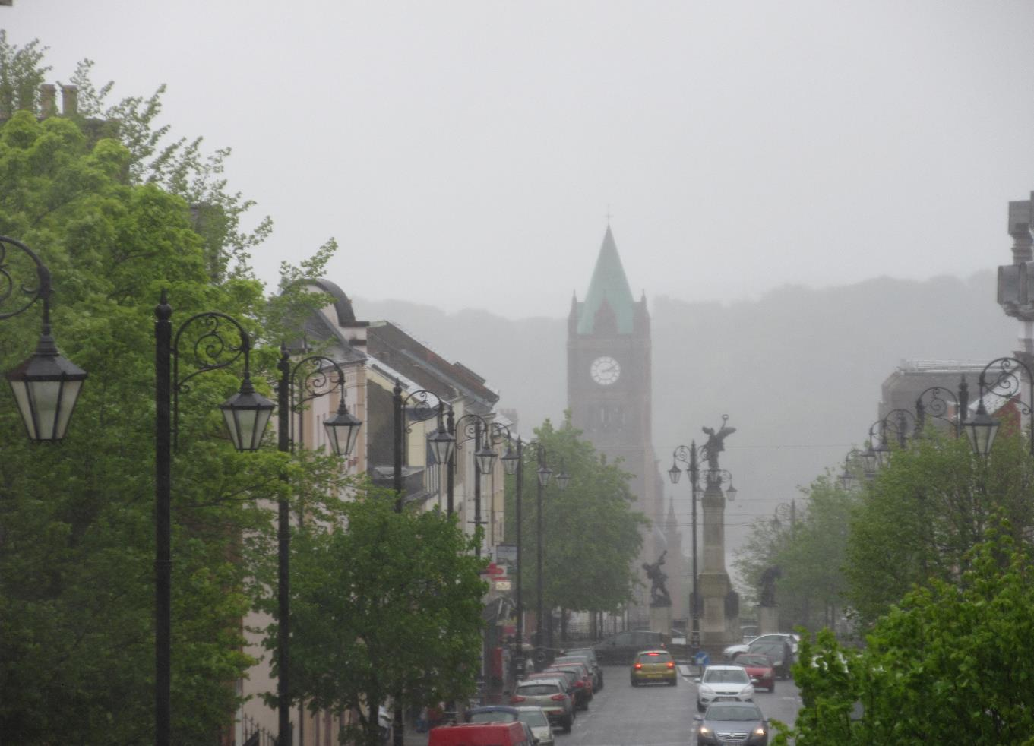
Cultural Center
A conflict “bubbling under the surface” of society (Finley-Bowman)

Slide 5
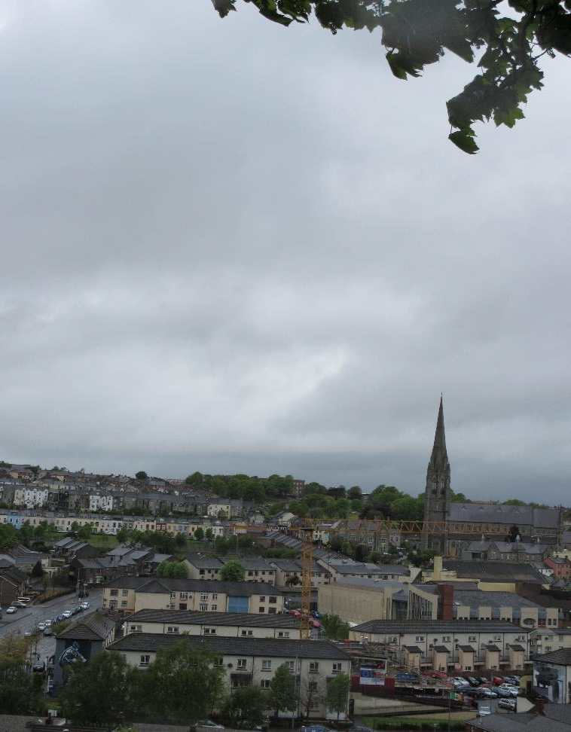
Derry
Londonderry
Derry-Londonderry
The Walled City
Where the Troubles began…
(Day the Troubles began)

Slide 6

(Guestbook Project)

Slide 7
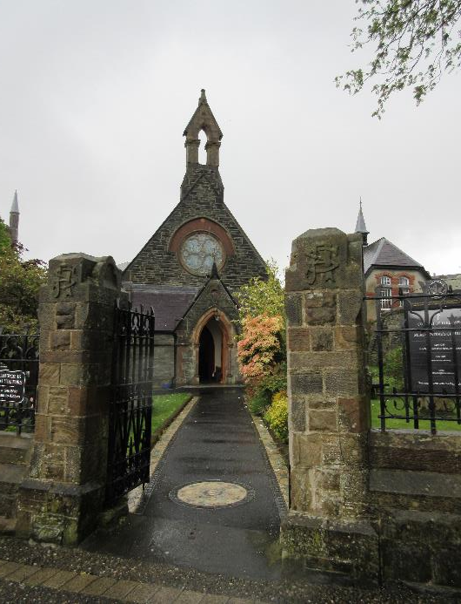
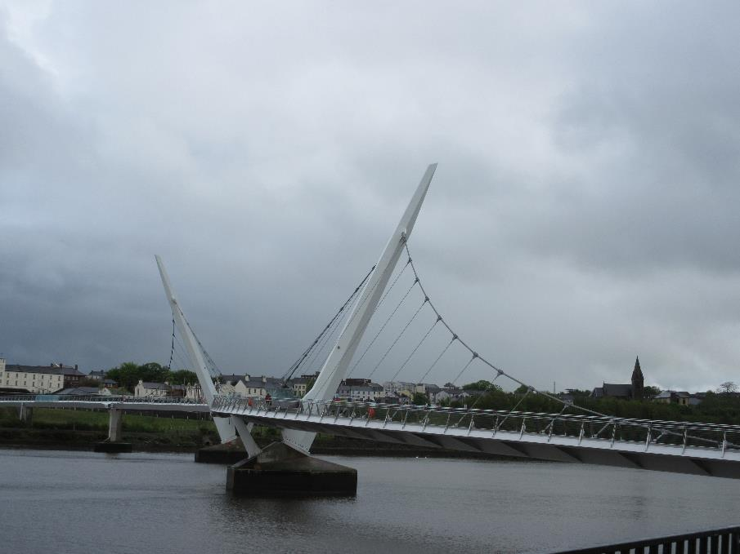
Religion
&
Division
“Who is who?”
(Guestbook Project 0:00-1:50)
“You look normal”
(Guestbook Project 2:35)
Walk along the wall
(Guestbook Project 3:30)
“I’m not from a different country”
(Guestbook Project 3:43)
“These uniforms label us as being different, but what if we combine them?” (Guestbook Project 4:45)

Slide 8
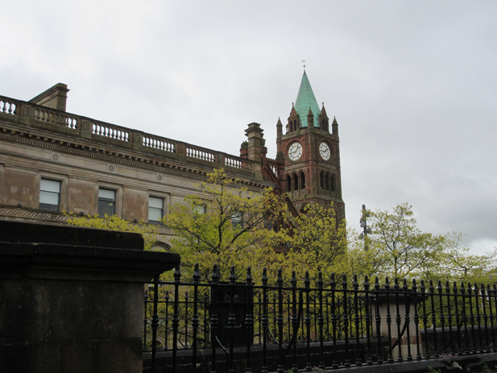
“We live in peace, but we live apart”
(Guestbook Project 5:25)

Slide 9
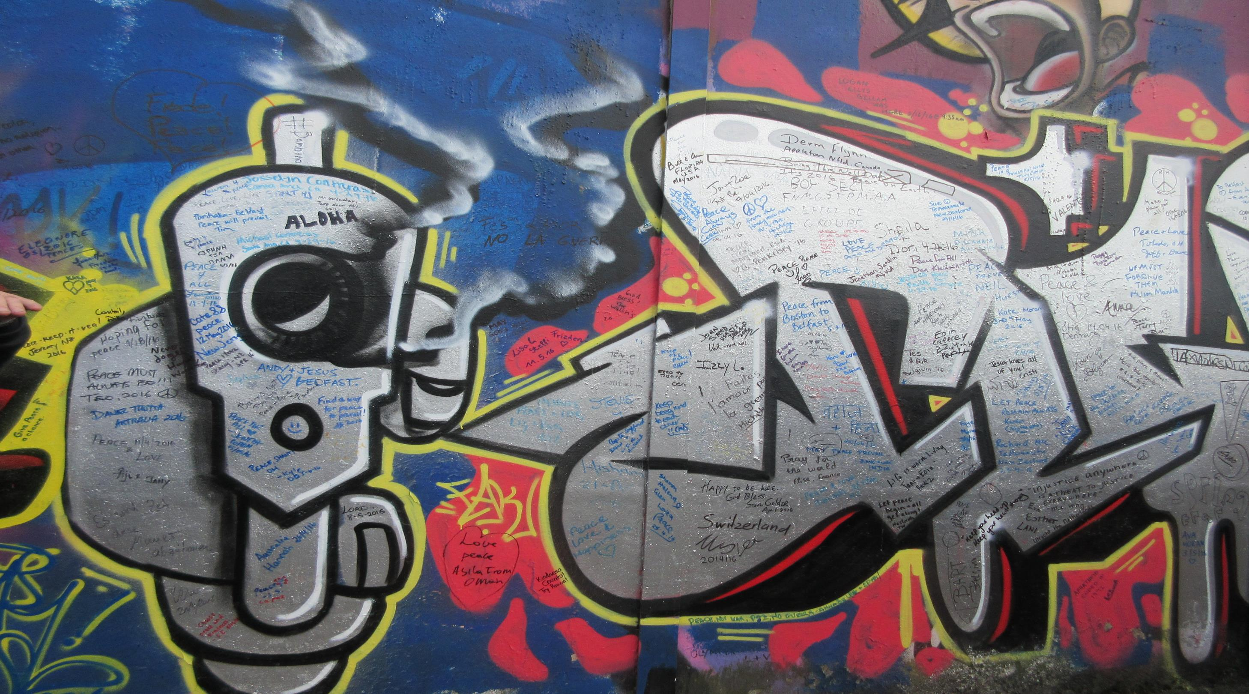
Segregation

