Slide 1
Protestants vs. Catholic Man vs. Man

Slide 2
“Pathways to Peace Conference”
Ann Van Dyke: countering violent extremism in Central Pennsylvania

Slide 3
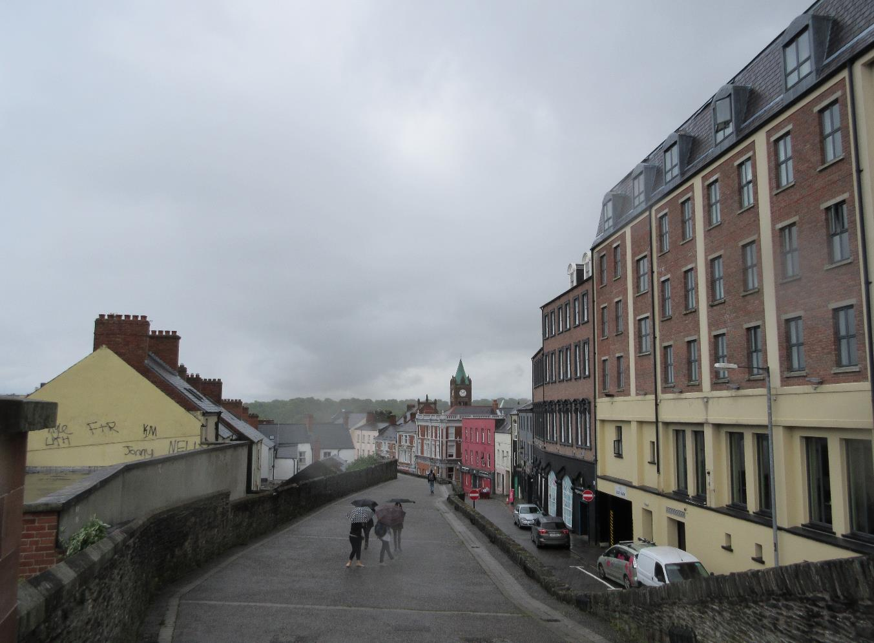
Extremist Groups Utilize
Identity
Alienation
Family language
Manipulative tactics
(Van Dyke)

Slide 4
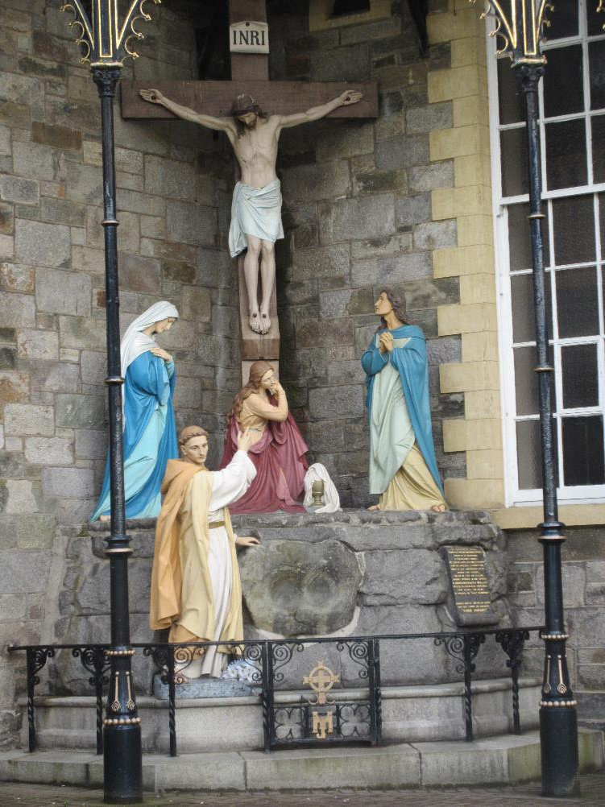
Religion as a Justification
Religions are inherently peaceful
Interpretations are to blame
Core values and identity exacerbate conflicts
(Goldstein and Pevehouse 168-169)
“Religious traditions strive for positive change, not isolation”
(Yesilova)

Slide 5
Extremist groups are symptoms, not the problem
Conditions that foster hate groups:
Instability
Fears of demographic change
Poor economy
Disconnection from youth
Lack of education
Why join an extremist group?
Alienation from society
Unstable home environment
Mental health
Poor well-being
Socioeconomic status
(Van Dyke)

Slide 6
Mental Health and Well-Being
Negative trend between students’ age and well-being
Well-being = “Levels of self-esteem and self-confidence; Levels of personal emotional regulation; Social and interpersonal skills…Mental well-being”
(Connolly et al. 15-19)

Slide 7
Bullying
In 2014, 22% of Catholics and 17% of Protestants were impacted by poverty (Sergie)
819 sixteen-year-olds in Northern Ireland
30% = victims of bullying
46% “not at all well-off”
31% “average” incomes
24% “well-off”
(qtd. in. Connolly et al. 17)

Slide 8
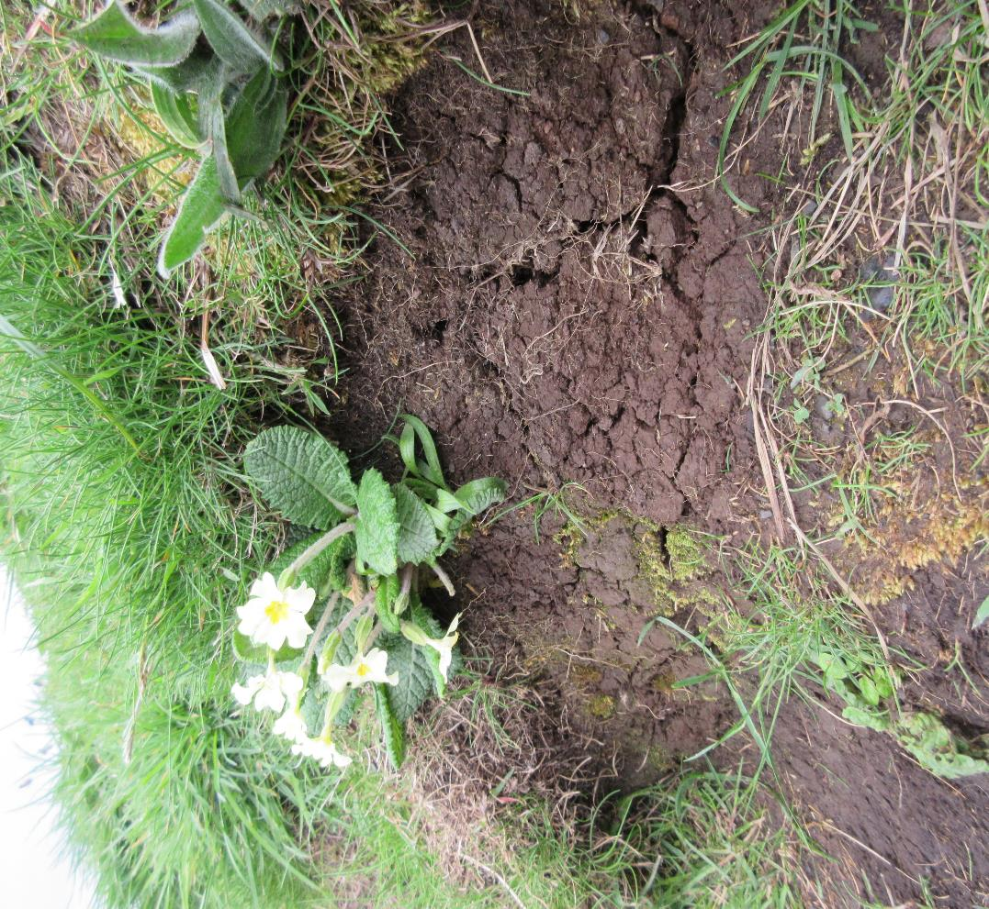
Peace Education
“[T]he process of teaching people about the threats of violence and strategies for peace”
(Harris 11)

Slide 9
Underlying peace education….
social interdependence theory
constructive controversy theory
integrative negotiations theory
(Johnson D. and Johnson R. 223)

Slide 10
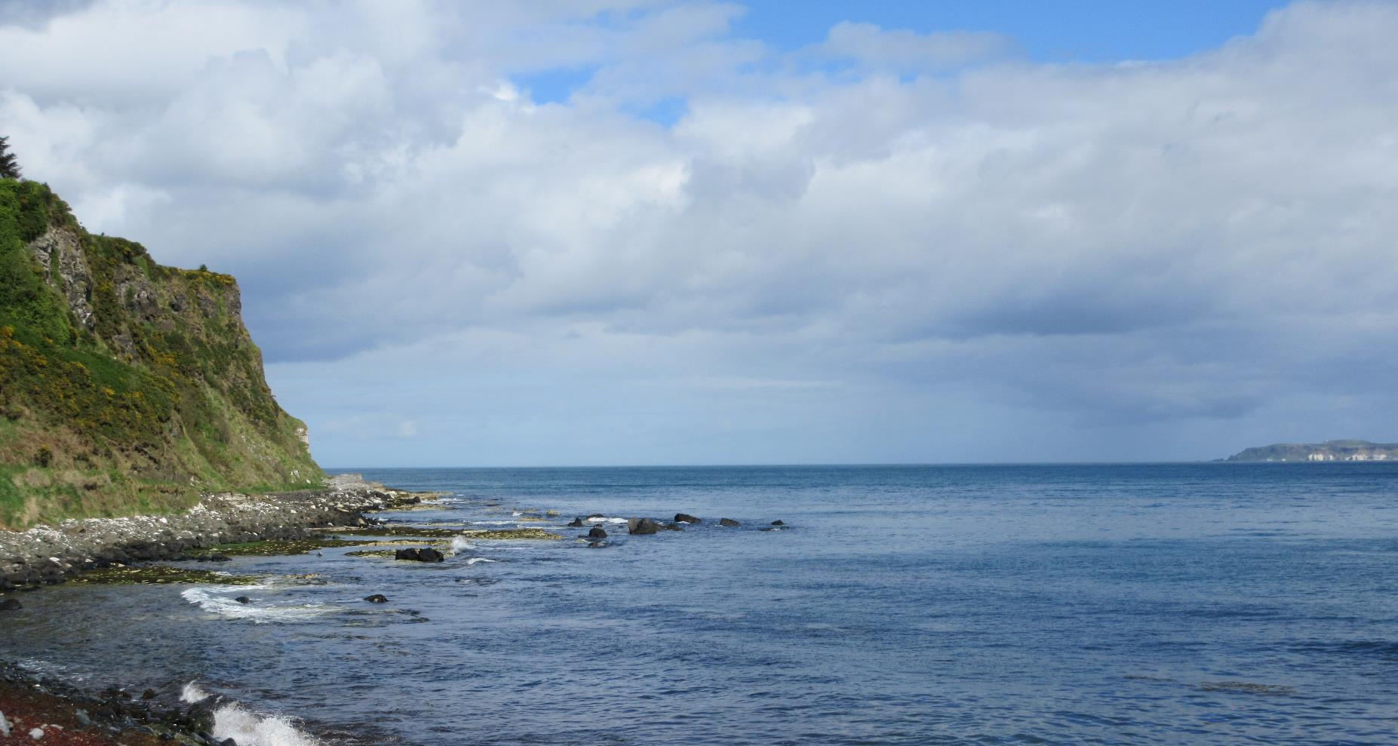
Five steps
Establish a program for interaction
Include mutual experiences
Teach decision-making procedures
Convey how to appropriately address and converse in a conflict
Enforce agreed upon morals and values
(Johnson D. and Johnson R. 223)

